Slide 1

Organ donation and transplantation
Swiss National Foundation for Organ Donation and Transplantation
Aline,
heart recipient
Bern | 2024
info@swisstransplant.org

Slide 2
Objectives of the presentation
Home
The Swisstransplant Foundation
Transplantation Act
Facts and figures
Organ donation procedure
Questions

Slide 3
Swisstransplant
01
Swisstransplant
Structure and organization

Slide 4

Swisstransplant – Swiss National Foundation for Organ Donation and Transplantation
Swisstransplant Foundation
1985
Creation of the Foundation in Geneva
Bern
2007
Allocation of organs to recipients in accordance with the law
2009
Allocation of benefits by the Swiss Conference of the Cantonal Ministers of Public Health
Coordination and development of organ donation at the national level
Mandated by the Federal Office of Public Health (FOPH) as the national allocation service
Management of the waiting list
Compensation in the organ donation process/financing of hospital staff (H+/SVK)

Slide 5


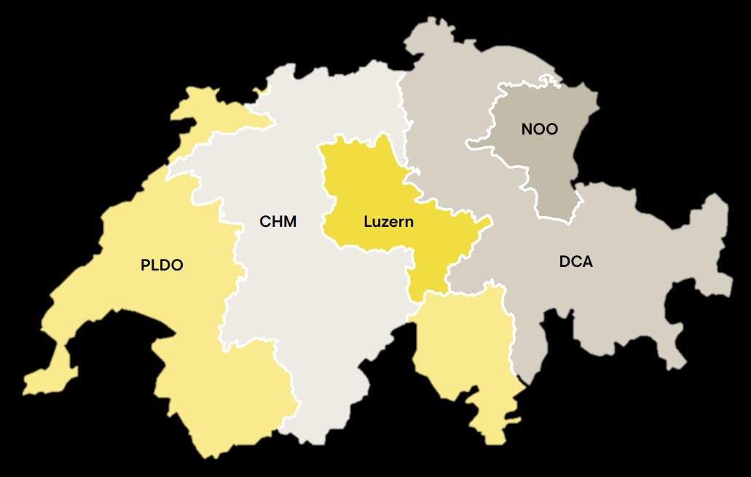





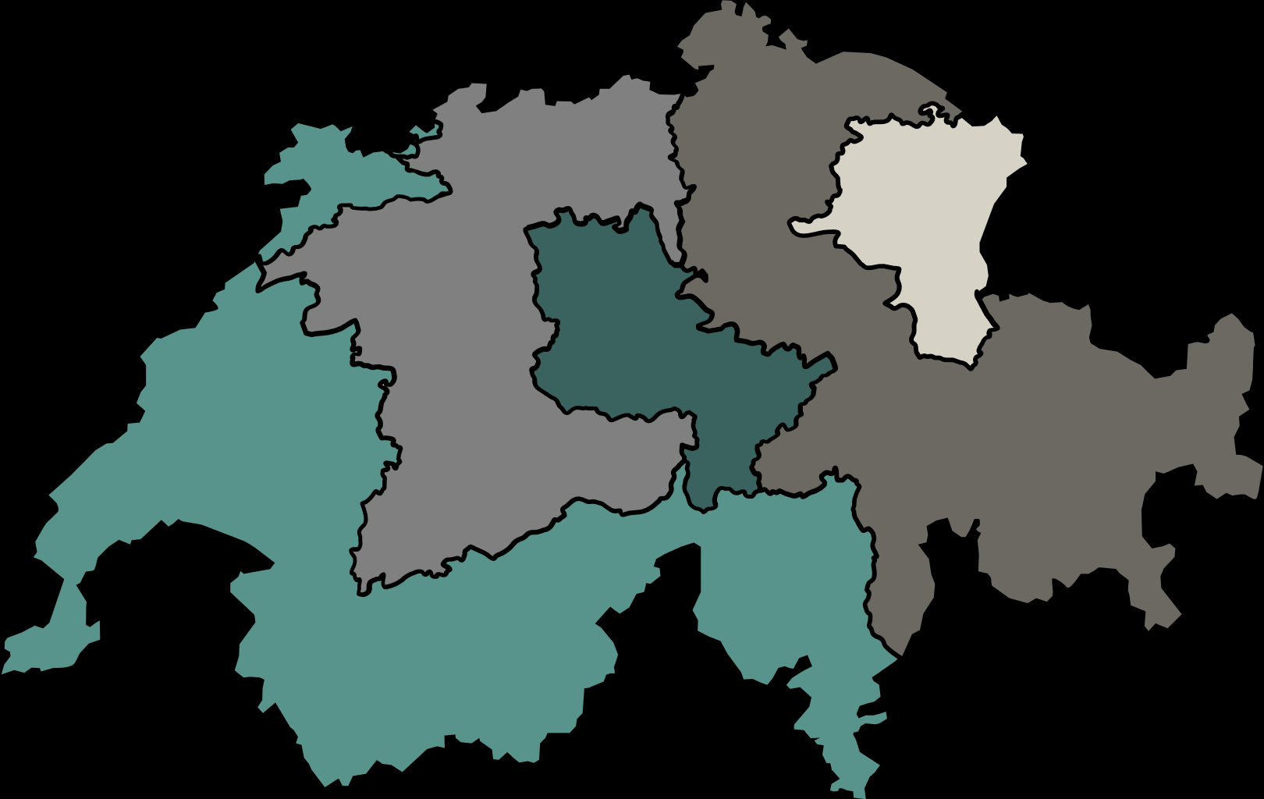
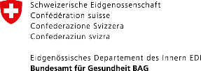

Collaboration
Partners
Organ donation
Organ donation networks
Transplantation
Transplant centres
International collaboration
Basel
Zürich
St.Gallen
FOEDUS – European Organ Exchange Organisation
CD-P-TO – European Committee on Organ, Tissue and Cell Transplantation
Bern
Lausanne
Genf

Slide 6
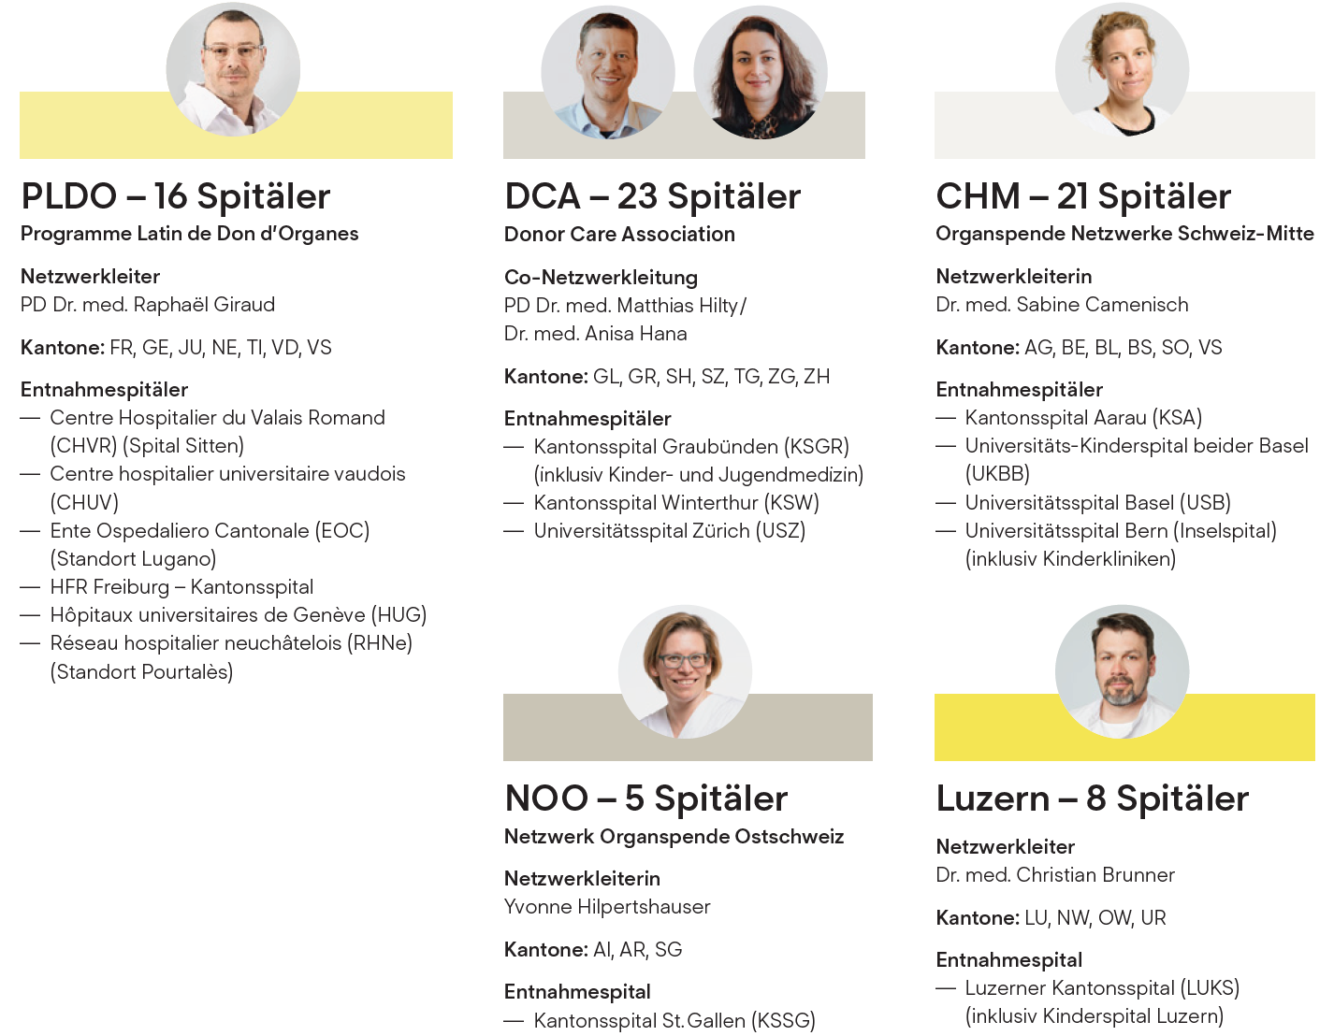
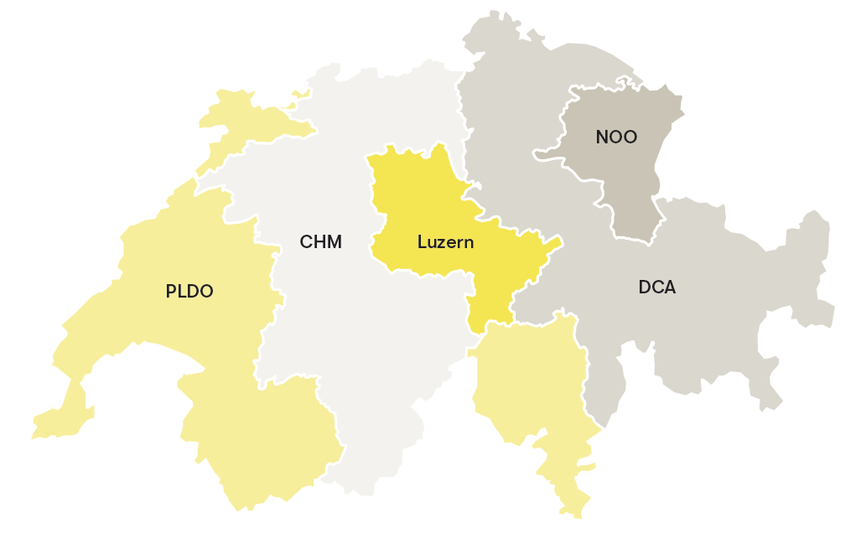
5 donation networks
Organization
  Swisstransplant mandated by the CDS for:
  Regional grouping of hospitals
  Training of medical staff
  Implementation of legal directives
  Implementation of standard processes
  Use of synergies at national level

Slide 7
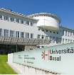
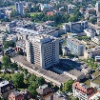
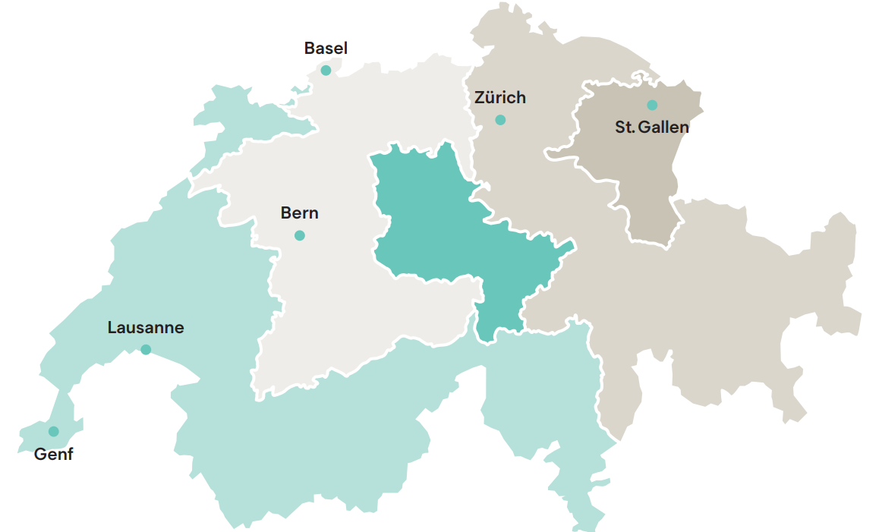

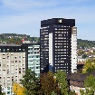
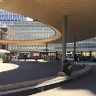
Transplant centres in Switzerland
Organization
University Hospital of Bern (Inselspital)
University Hospital of Basel (USB)
University Hospital of Zurich (USZ)
University Hospital of Vaud (CHUV)
NOO
Cantonal Hospital of St. Gallen (KSSG)
LU
CHM
DCA
University Hospital of Geneva (HUG)
PLDO

Slide 8
Transplantation Act
02
Swisstransplant
Politics and society

Slide 9
Transplantation Act
Politics and society
  Federal Act on the Transplantation of Organs, Tissues and Cells (Transplantation Act), 2007
      Replaced cantonal legislation regulating donor and recipient aspects
      Creation of a national allocation service
  Essential points of the law
      Principle of free access and prohibition of trade
      Principle of explicit consent in the broader sense*
      Organ allocation according to by-laws
      * On 15 May 2022, the people approved the principle of presumed consent in the broad sense. The new regulation will come into force in 2026 at the earliest (bag.admin.ch).

Slide 10
Politics and society
What is the extended opt-out solution?
If a person objects to organ donation while they are alive, they are no longer an organ donor. ​
If the deceased person made no statement regarding organ donation prior to their death, the next of kin are consulted. “Do you know if the deceased stated or would state that they do not want to be an organ donor?”
If there is no objection or any other statement regarding the willingness of the deceased to be a donor, and if no next of kin can be found despite efforts being made, no organs may be removed.

Slide 11
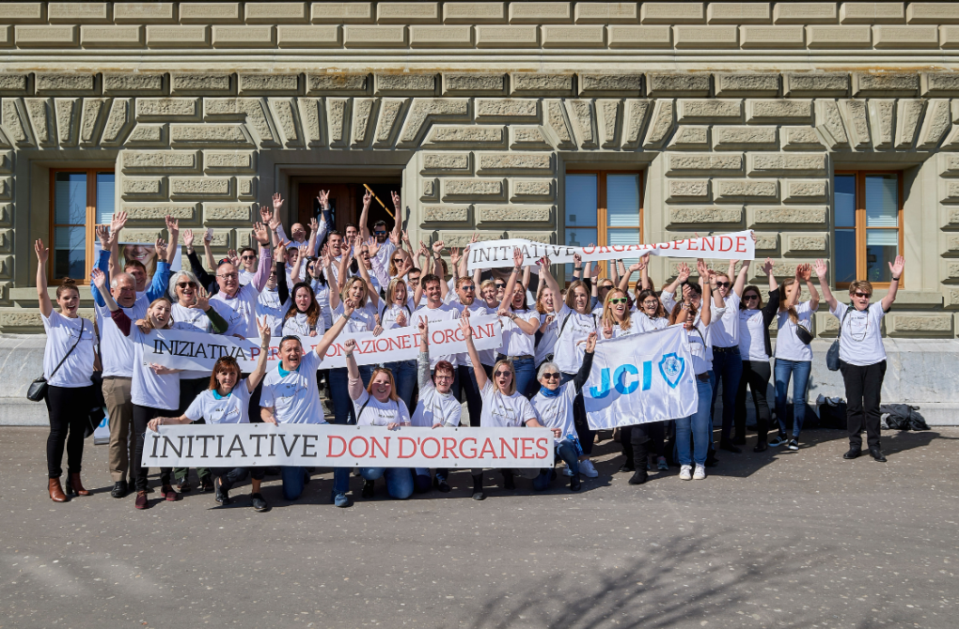
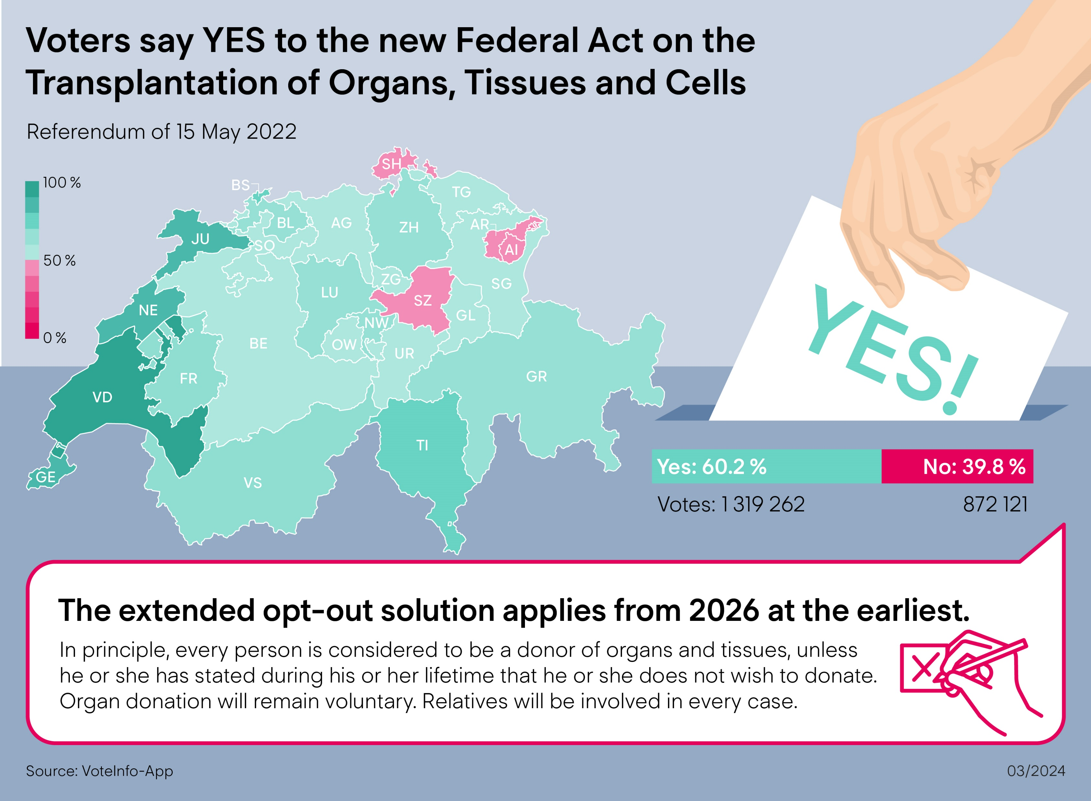
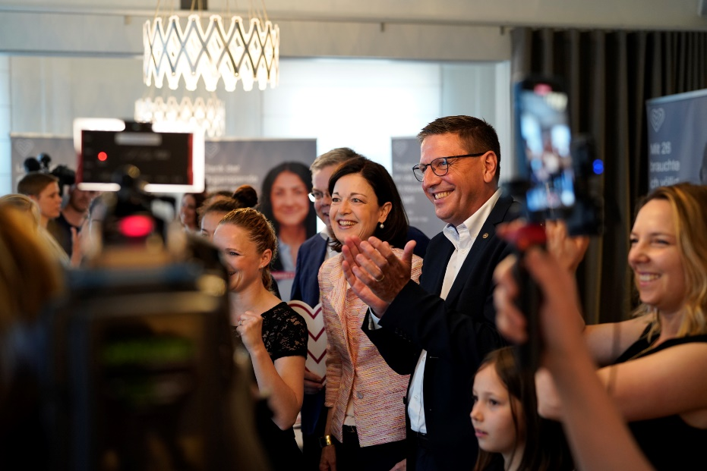
Change of system: Extended opt-out solution
Politics and society
60.2 % yes

Slide 12
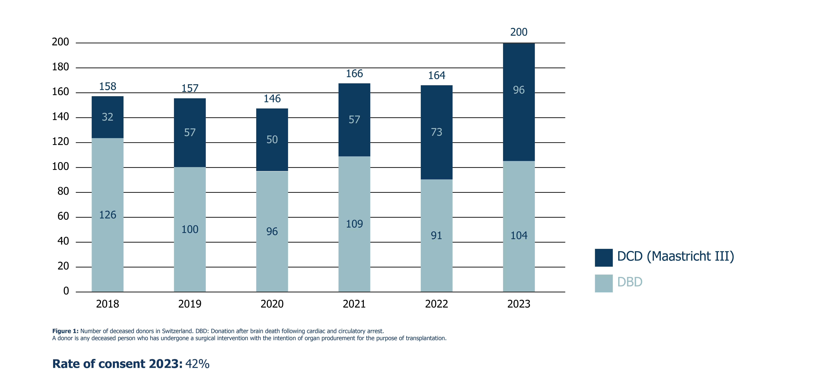
Politics and society
Effective numbers of deceased donors

Slide 13
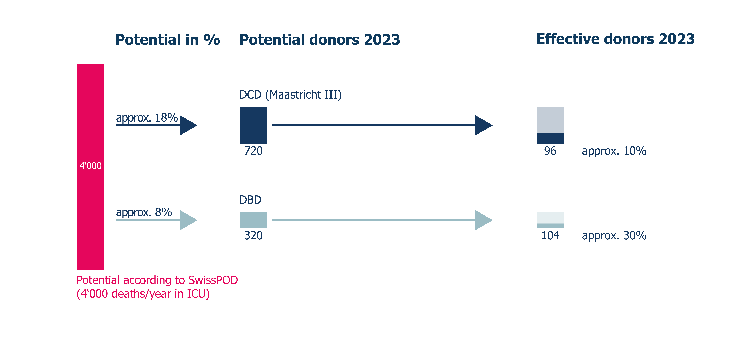
Politics and society
Effective organ donors

Slide 14
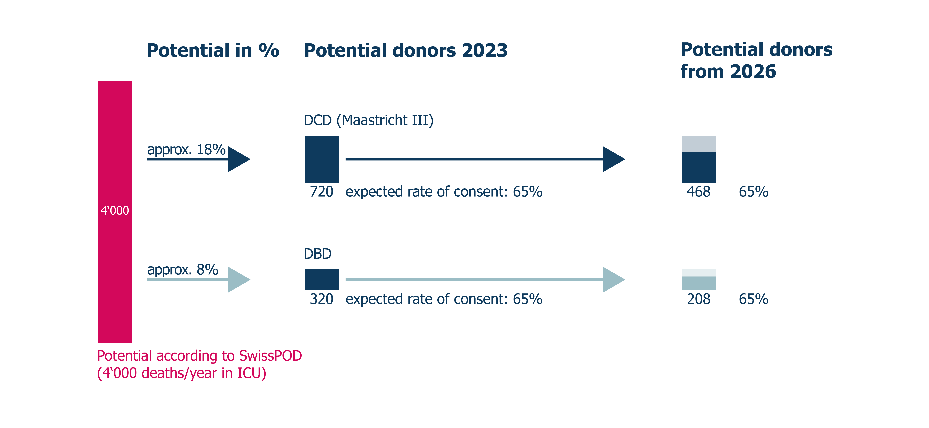
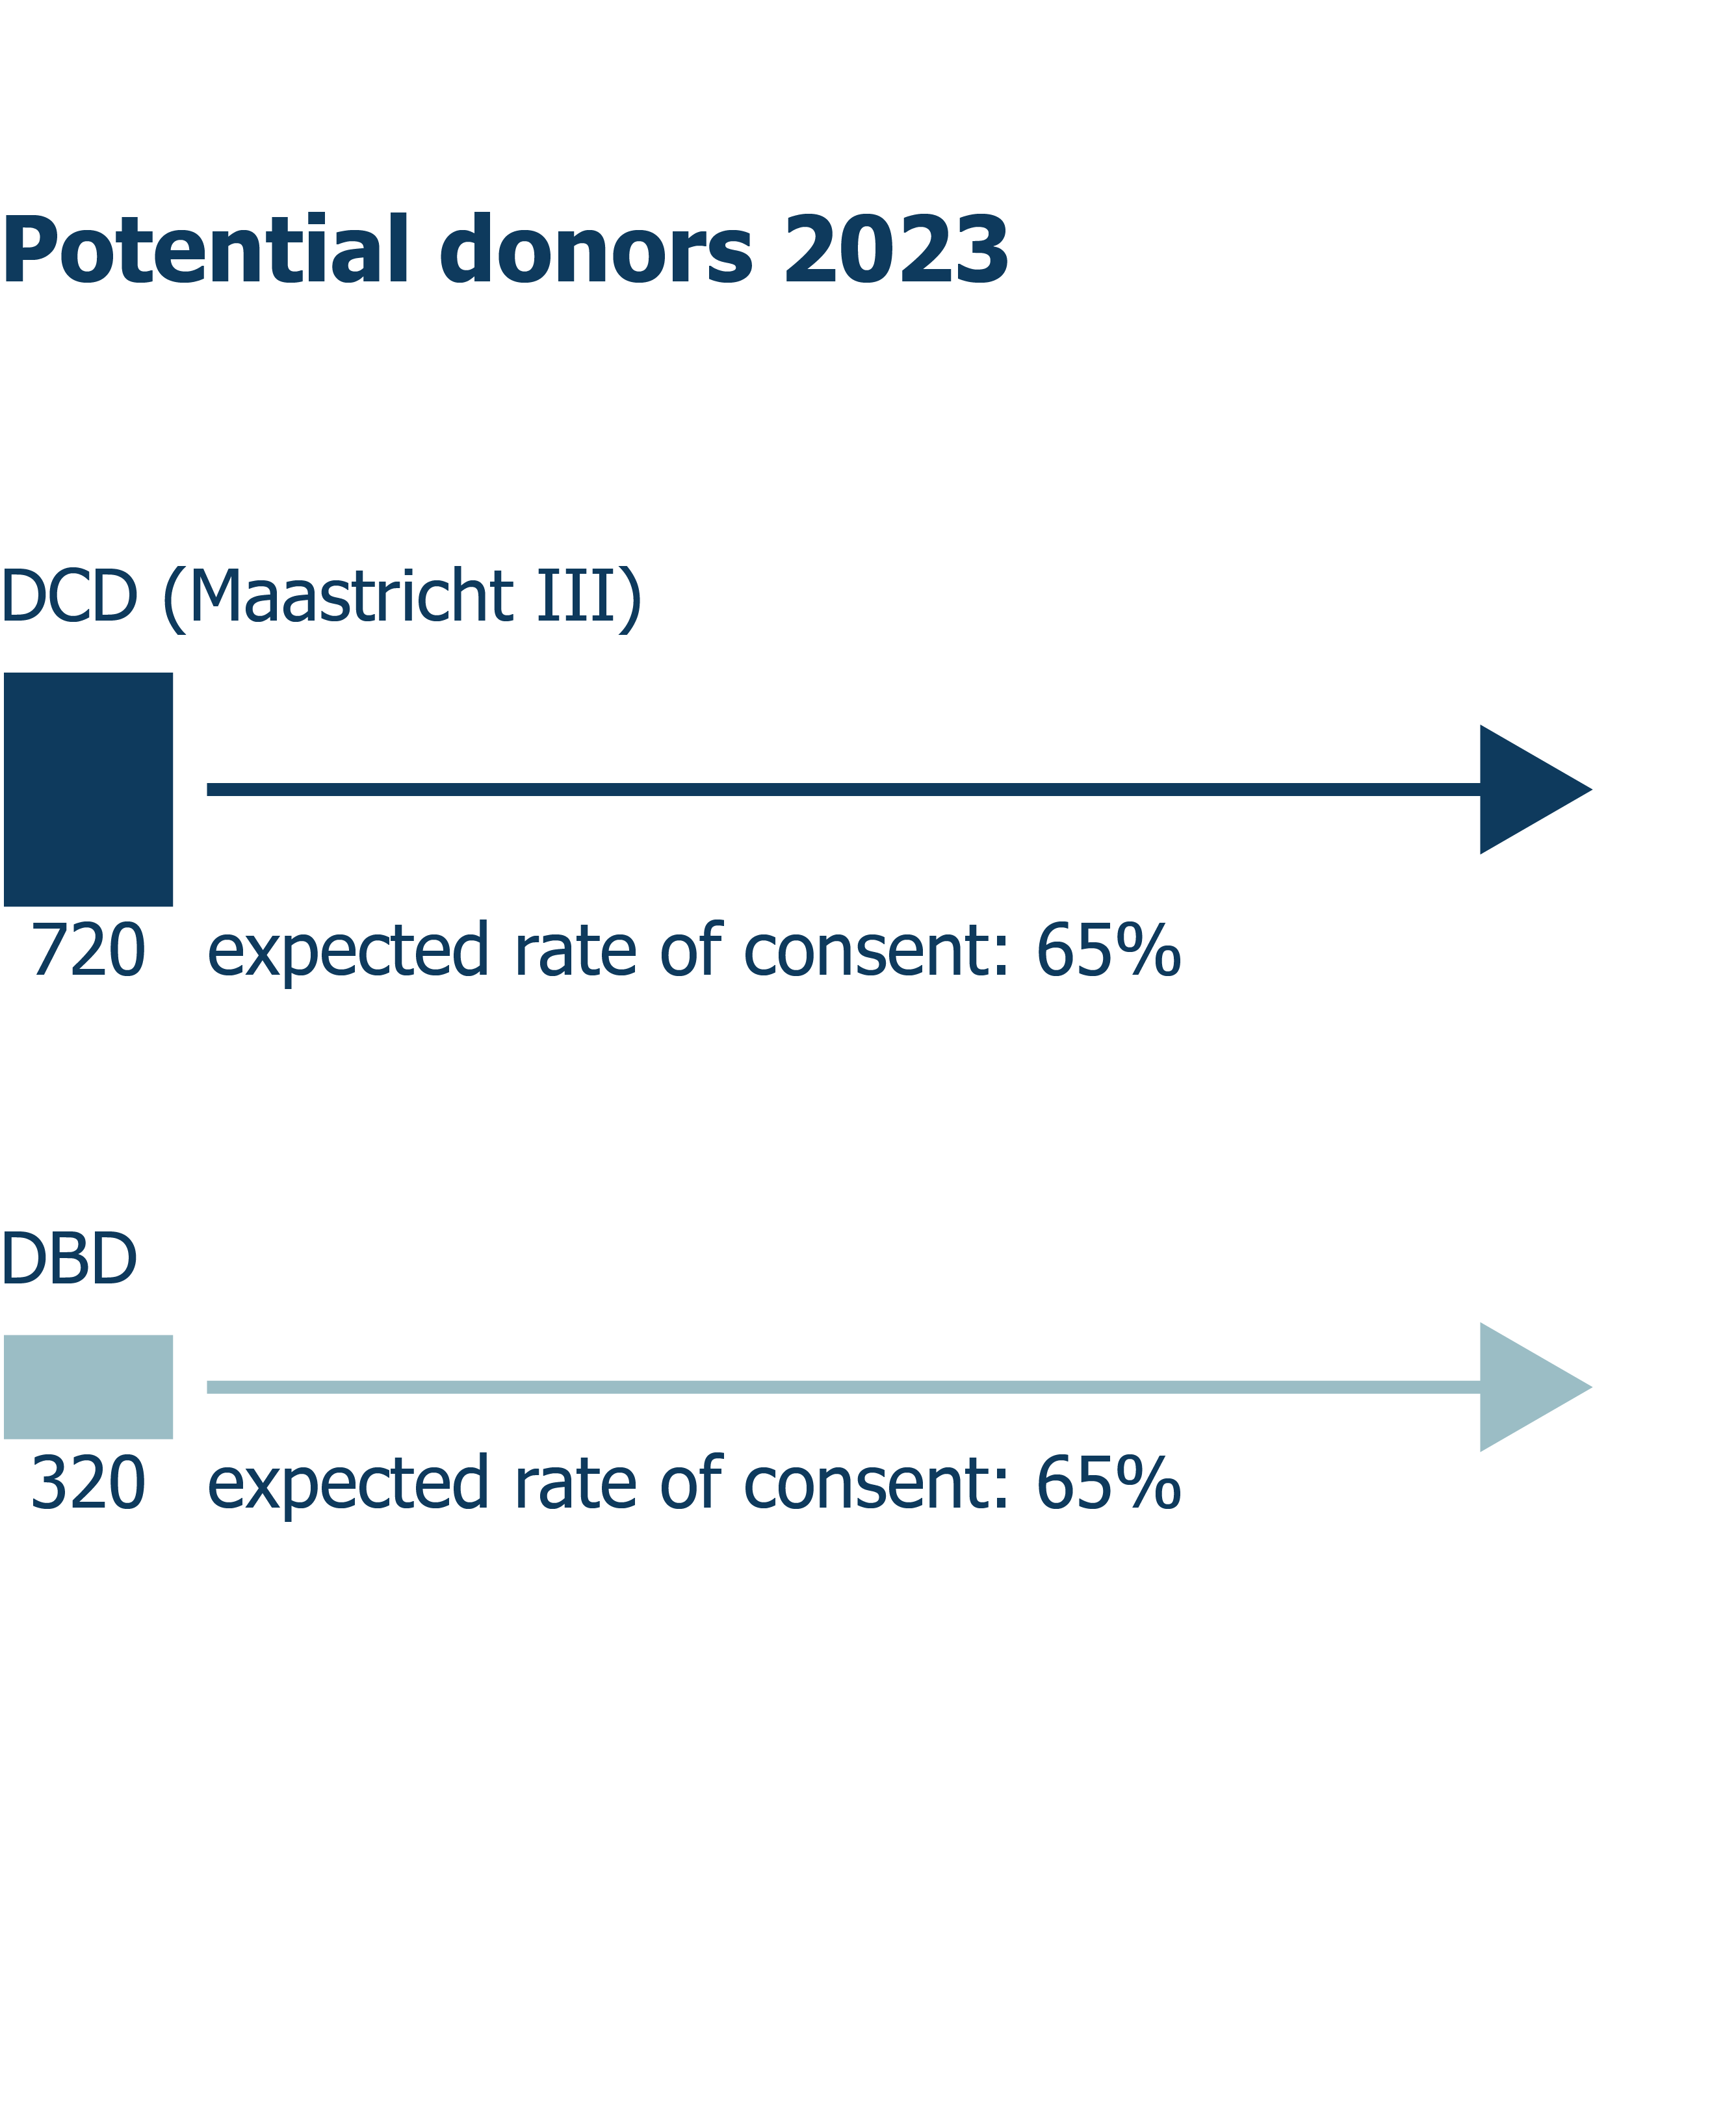
Politics and society
Potential organ donors from 2026 onwards

Slide 15
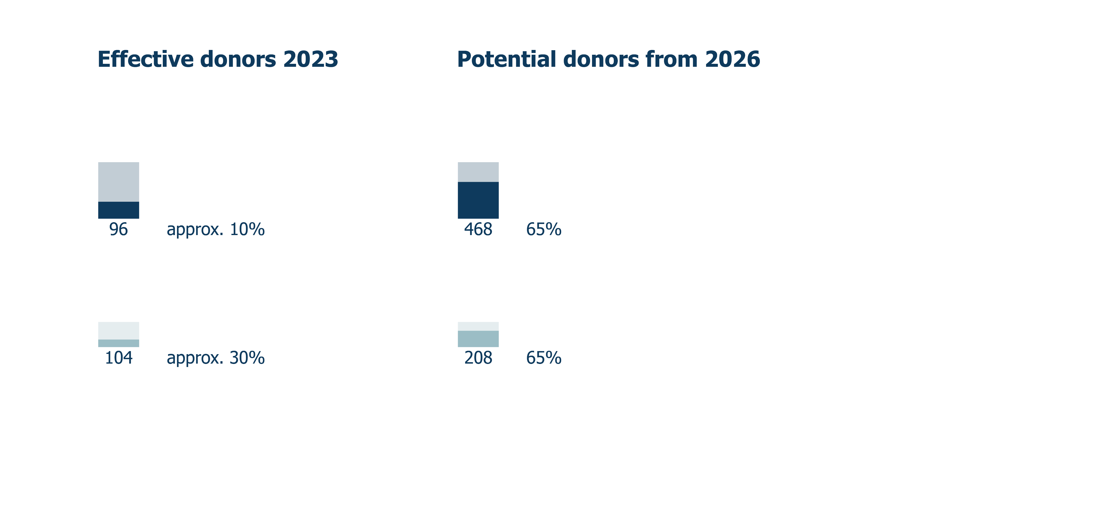
Politics and society
Organ donation potential Switzerland

Slide 16
Facts and figures
03
Swisstransplant
Organ donation in Switzerland

Slide 17
Organ donation in Switzerland
A decision for life
74 %
In favour
43 %
Decision not held
58 % refusal of relatives
60.2 %
Yes to the extended opt-out solution
GFS Bern (2019), SwissPOD (2023)
Notes:
Bereitschaft Organspende – 74%:
In einer Erhebung von gfs Bern im Jahr 2019 zeigten sich 74% der Stimmbevölkerung grundsätzlich bereit, nach dem Tod ihre Organe zu spenden.
Entscheid nicht festgehalten – 43%:
Gemäss einer repräsentativen Umfrage von gfs Bern im Jahr 2019 haben 43% der Stimmberechtigten, die einen Entscheid zur Organspende getroffen haben, ihren Entscheid weder schriftlich festgehalten noch den Angehörigen mitgeteilt.

Slide 18
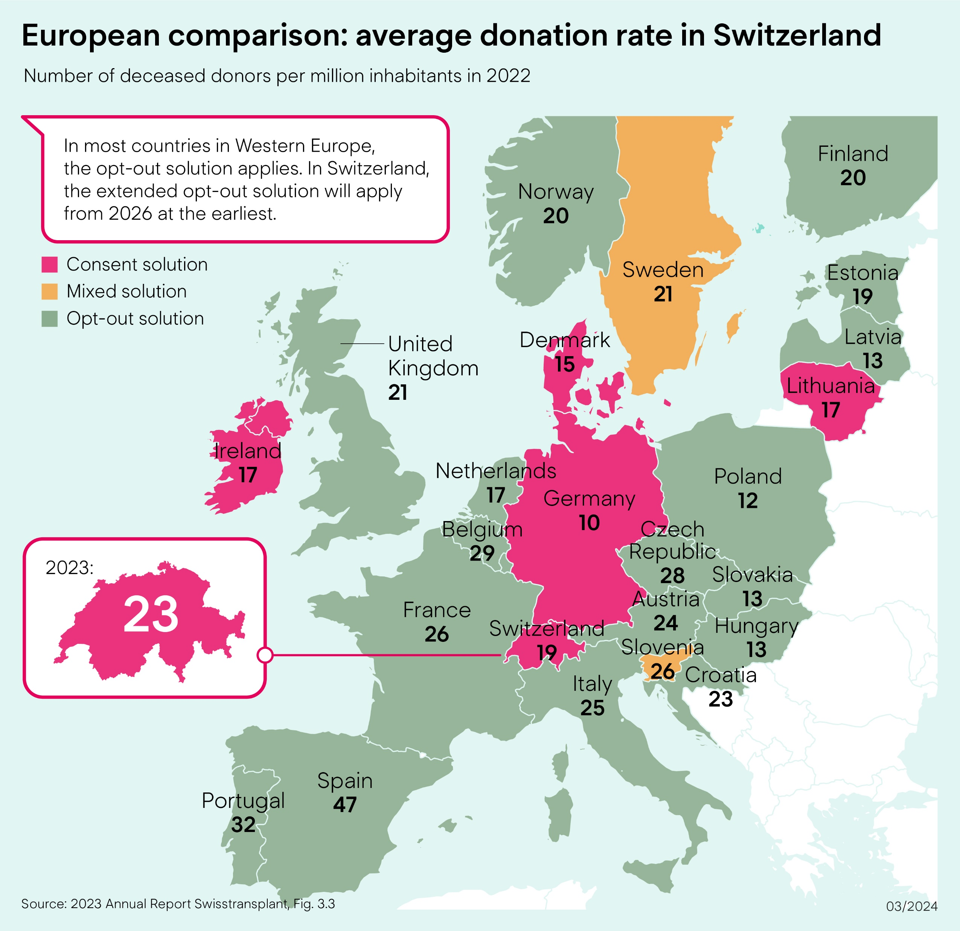
Donation rate in Europe
Regulations international

Slide 19
Swisstransplant annual figures − deceased donors
Facts and figures
Swisstransplant

Slide 20

Post-mortem donation
Facts and figures
  DBD: donation after brain death
      Brain-dead donor
        Circulation mechanically stabilized
        Donation of all organs possible
  DCD: donation after cardiocirculatory death
      Non-heart-beating donor
        Change of therapy – not brain-dead
        Donation of all organs possible

Slide 21
Transplantation through living donation
Facts and figures
  Living organ donation in Switzerland
        A kidney or part of the liver
        Directed donation
        Altruistic donation
        Crossed donation

Slide 22
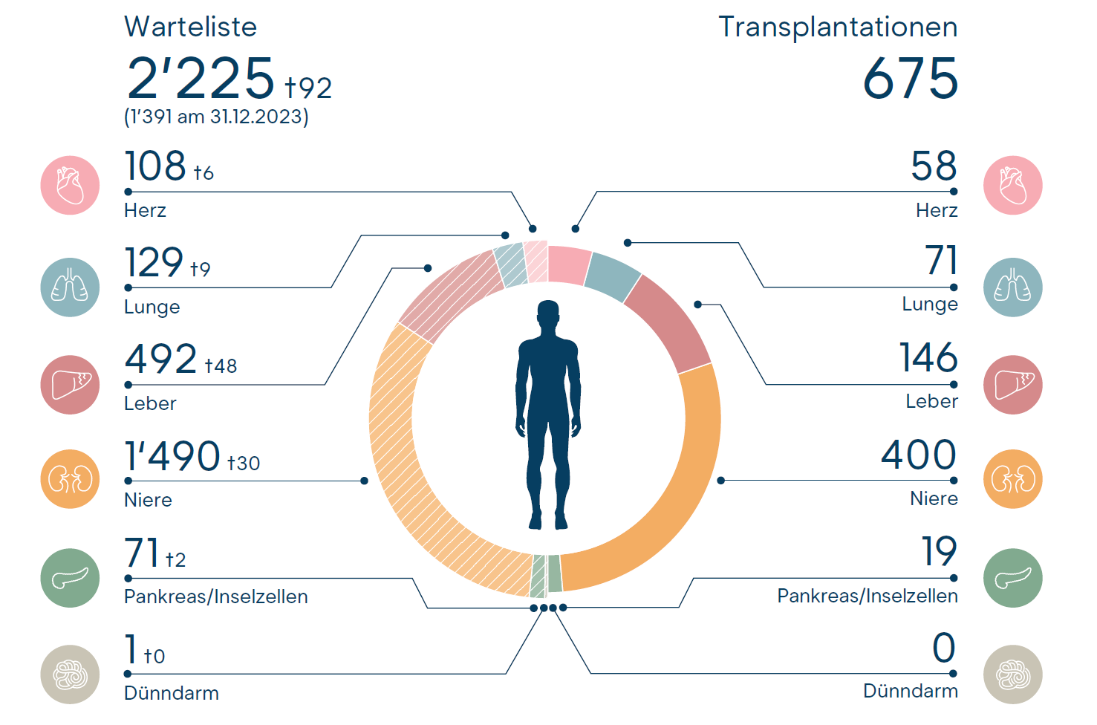
Waiting list and transplantations (1 Jan.−31 Dec. 2023)
Facts and figures
Annual report Swisstransplant 2023

Slide 23




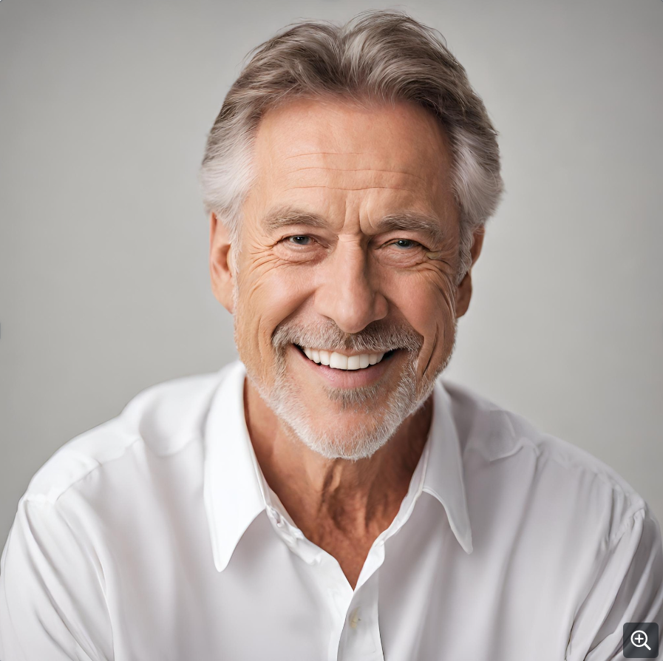
Typical example
Facts and figures
60 years old

Slide 24
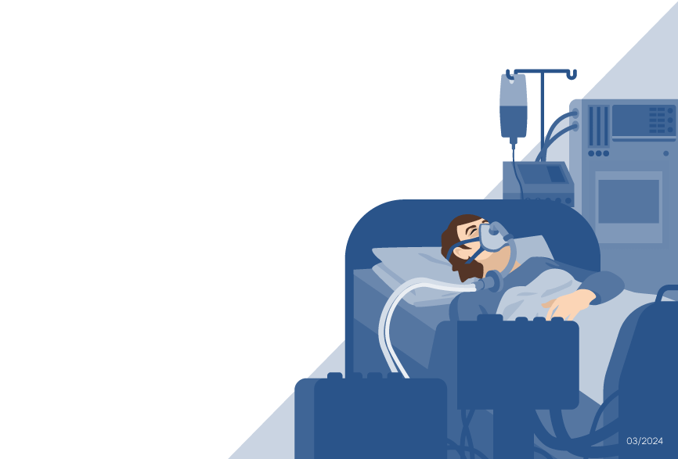
Causes and frequency of death in organ donors – Distribution in %
Facts and figures
n total = 200 donors

Slide 25
Causes and frequency of death in organ donors – Distribution in %
Facts and figures
(30)
(30)
(30)
(30)
(30)
(30)
(30)
n total = 104 donors
n total = 96 donors
rounded values

Slide 26
Absolute medical contraindications
Facts and figures
Untreatable sepsis
Degenerative disorder CNS*
Rabies virus, prion disease (e.g. Creutzfeldt-Jakob disease CJD)
*CNS = central nervous system

Slide 27
Brain death
Post-mortem donation
  Irreversible failure of the brain and brain stem
      The organs receive the oxygen they need to continue functioning through mechanical ventilation.
  Brain death: not to be confused with coma
  Coma: potentially reversible partial lesions of the brain. Patients react to certain stimuli; measurable brain activity.

Slide 28
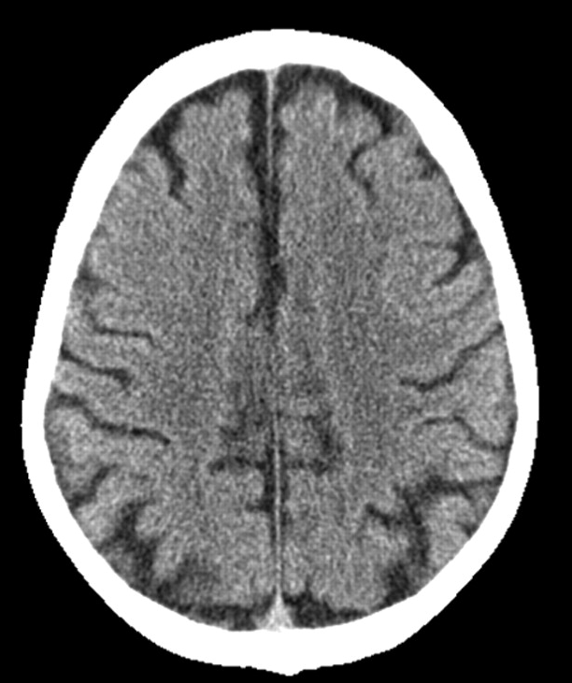
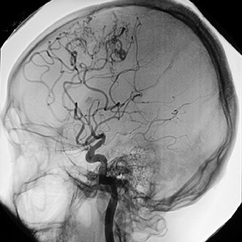
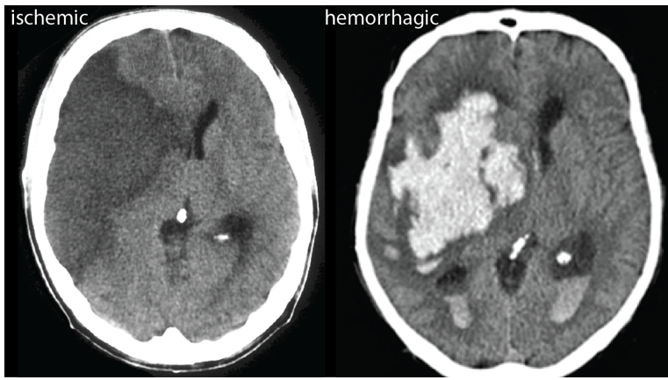
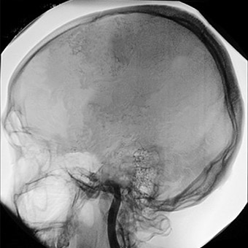
Brain death – diagnosis through imagery
Post-mortem donation
Normal circulation
  Interrupted circulation
      MRI/angiogram of a brain with normal circulation
CT scan/angiogram of brain with interrupted circulation
M. van Straten (2007); American Journal of Neuroradiology 28 (3) 421-427, https://donatelifecalifornia.org/ und Kummer (2019); https://ysjournal.com/

Slide 29
Brain death − natural process vs. process in intensive care unit
Post-mortem donation
Natural process:
Process in intensive care unit:
Increased intracranial pressure
Interruption of blood flow
Total loss of brain function
Respiratory arrest
Severe brain damage
Cardiac arrest
Increased intracranial pressure
Interruption of blood flow
Total loss of brain function
Mechanical respiration/stabilisation of circulation
Severe brain damage
Maintenance of blood perfusion to the organs

Slide 30


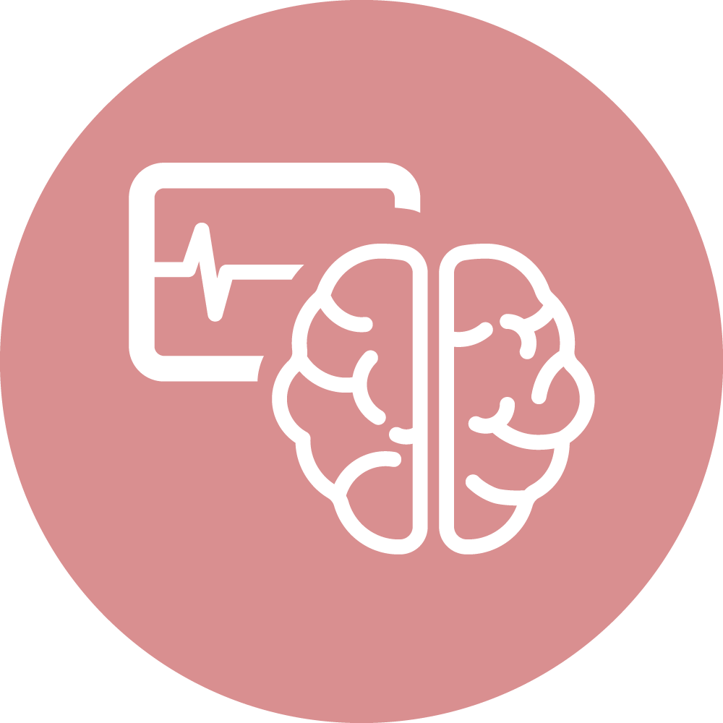

Who can be a donor?
Post-mortem donation
Mechanically ventilated and stabilized circulation
Brain death of known cause
No medical contra-
indications
Consent to organ donation

Slide 31
Process of organ donation
04
Swisstransplant
Procedure

Slide 32

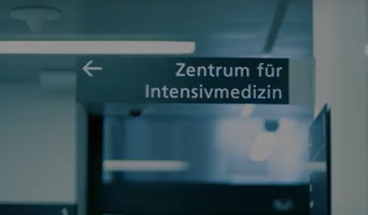


Procedure
Process of organ donation
  1. Hospitalization
  2. Intensive care
      Mechanically ventilated
      Medication maintains circulatory function
      If the brain and brain stem functions are irreversibly affected, there is no possible further treatment
  Saving the patient is always the priority. Organ donation is only discussed when this is not possible.

Slide 33
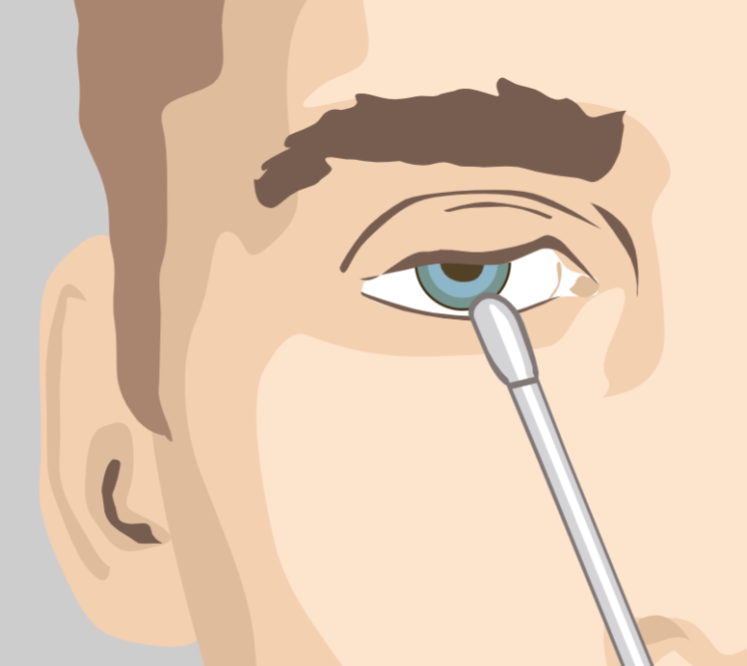
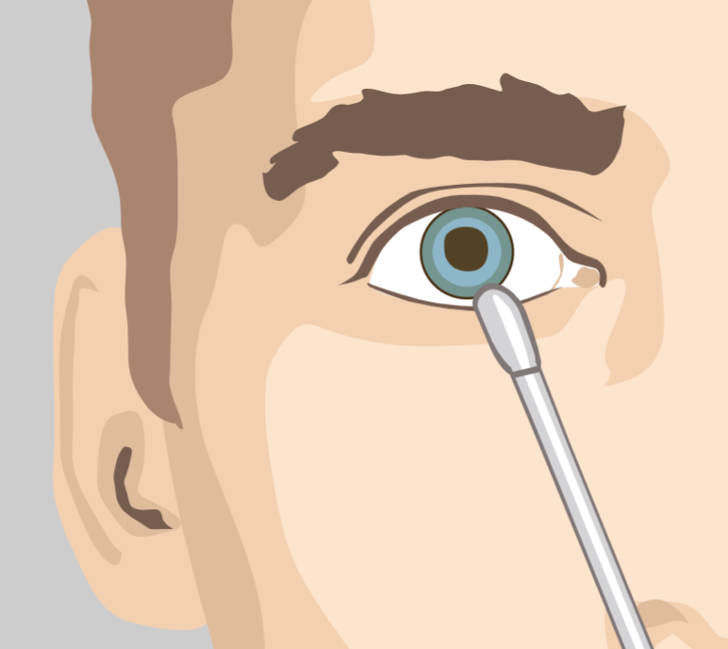
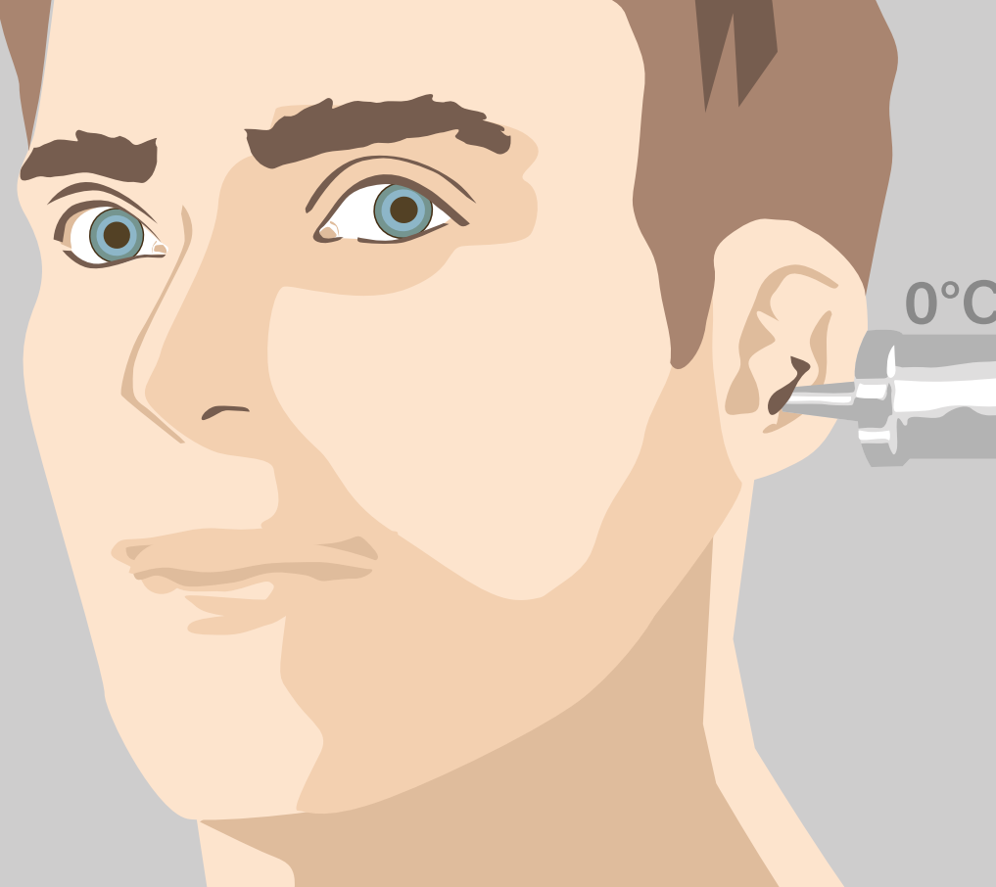
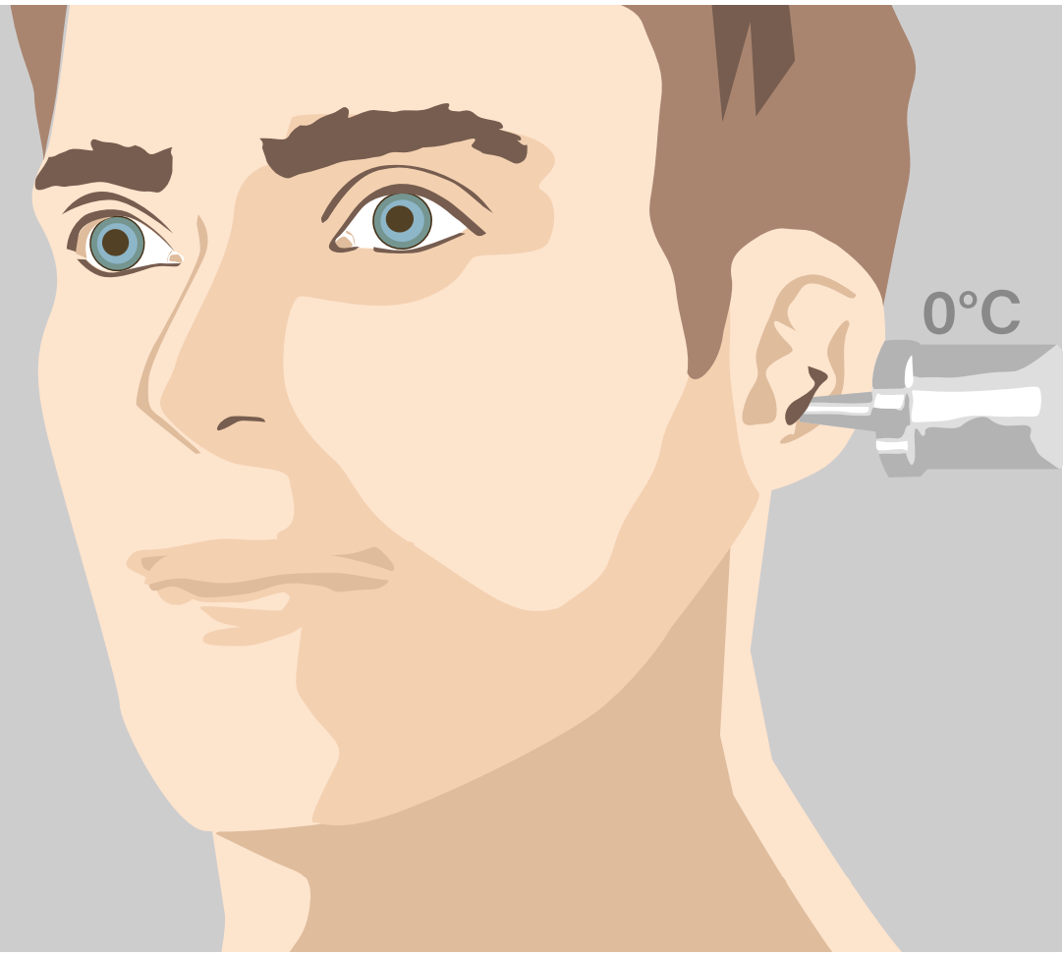
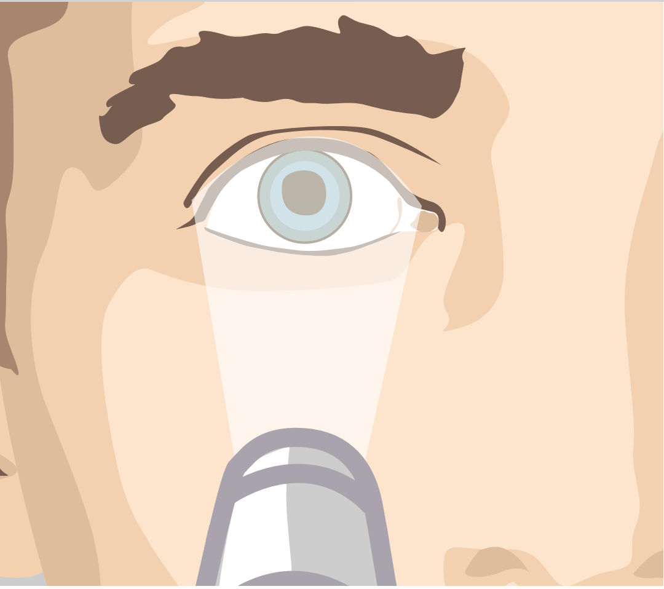
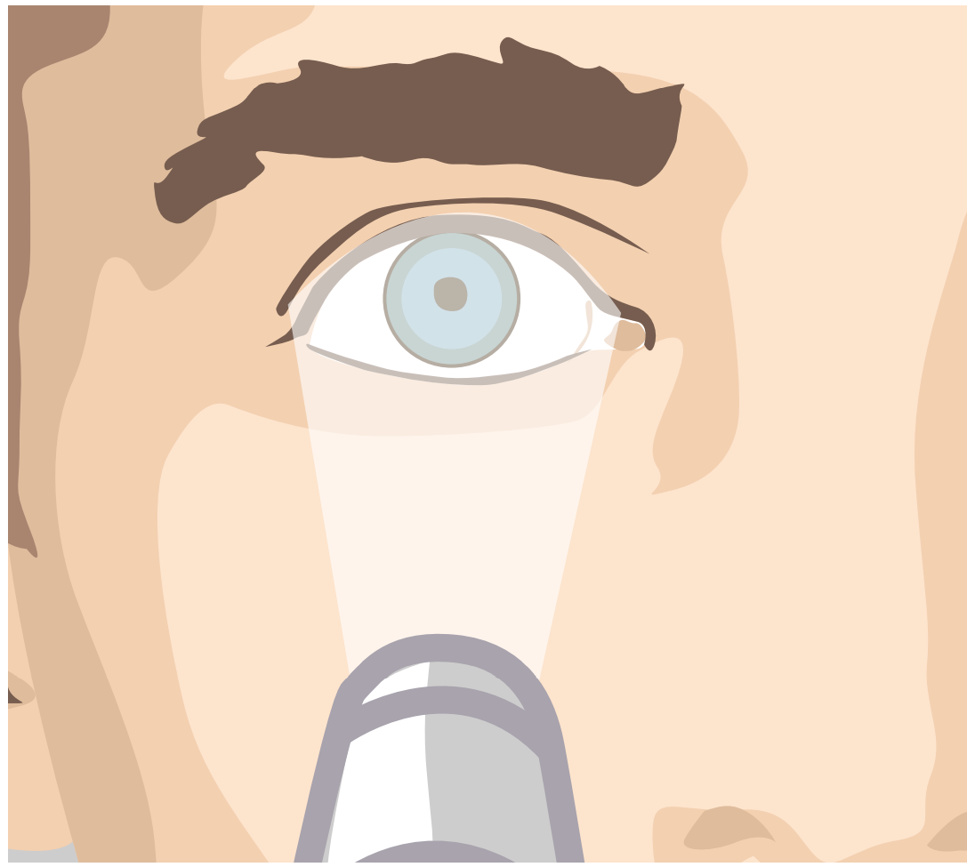

Procedure
Process of organ donation
  3. Diagnosis of brain death
      Carried out by two impartial specialists who are not involved in the transplant procedure
      7 clinical signs: brainstem reflex test
      Examples of normal and pathological reactions
Corneal reflex
Vestibulo-ocular reflex
Mydriatic test

Slide 34
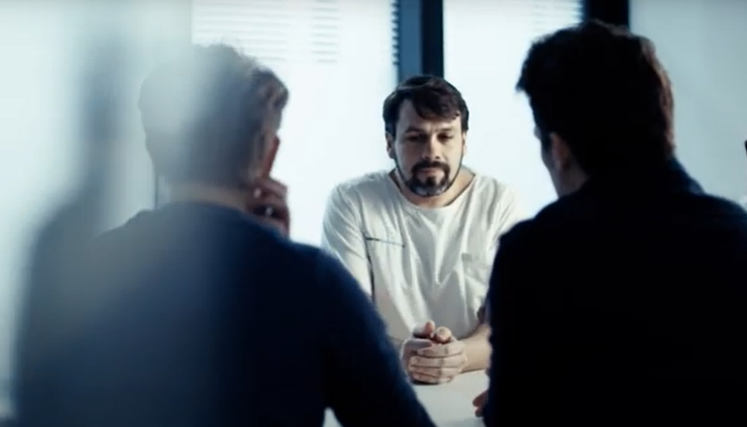

Procedure
Process of organ donation
  4. Consent
      First approach: informed of brain death/life-threatening condition
      Second approach: question of wishes of the deceased regarding organ donation
No urgency for the decision

Slide 35
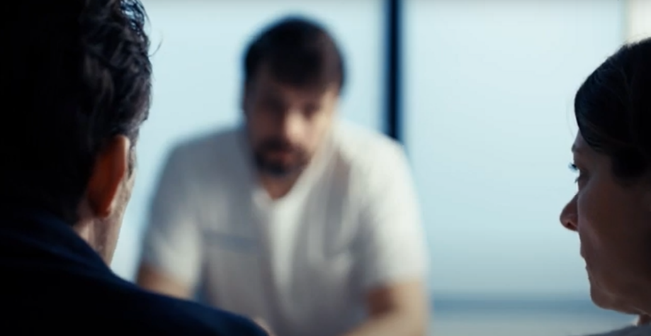
Procedure
Process of organ donation
      5. Discussion with relatives
      Away from the patient’s bed
      Announcement of death or hopeless diagnosis and change of treatment
      Organ and tissue donation discussed
      6. Time frame
      Maximum of 48 hours between the change of treatment and brain death (otherwise DCD donation)
      Organ procurement must be completed within 72 hours of the diagnosis of brain death

Slide 36


Procedure
Process of organ donation
  7. Swisstransplant
      Permission given
      Brain death/change of treatment
      Data entry of the deceased:
        Case history
        Results
        Laboratory tests
        Imagery

Slide 37
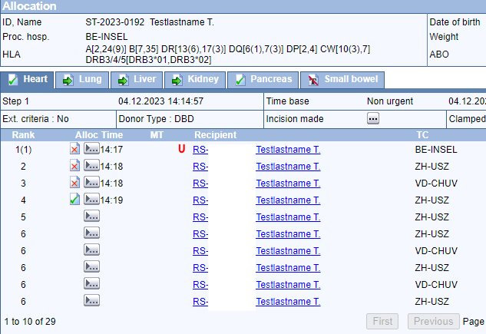
Procedure
Process of organ donation
  8. Waiting list/ranking
      Data entry in the SOAS
      (Swiss Organ Allocation System)
      Swisstransplant – calculation of the ranking
      of the potential recipients using SOAS software
      The ranking list depends on donor characteristics
      fictitious example SOAS

Slide 38

Procedure
Process of organ donation
  9. Attribution
      The ranking list is calculated on the basis of the distribution rules of the law using an algorithm
      Swisstransplant offers organs to centres for potential recipients
1
2
3
4
Medical urgency
Medical
benefit
Priority
(children/blood
Group)
Waiting
time

Slide 39
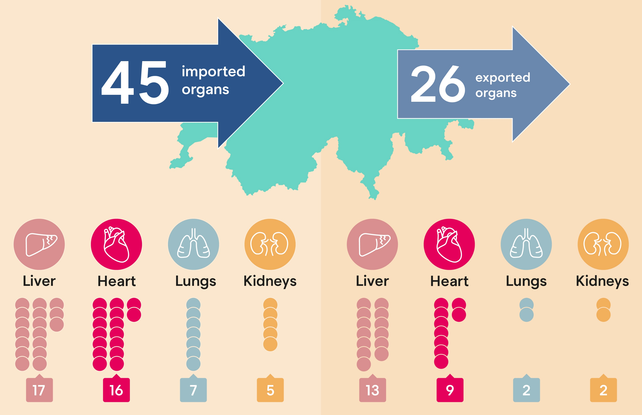
Process of organ donation
Procedure
  9. Attribution
      Cooperation with European allocation centres
BE
LS
ZH
SG
GE
ABM
Annual report Swisstransplant 2023

Slide 40

Procedure
Process of organ donation
  10. Planning
      Timing: everything at the right time and place
      Limiting factors:
        Availability of operating rooms
        Anaesthesia team, procurement team
        Hospital routine
        Flight time, workload, weather

Slide 41
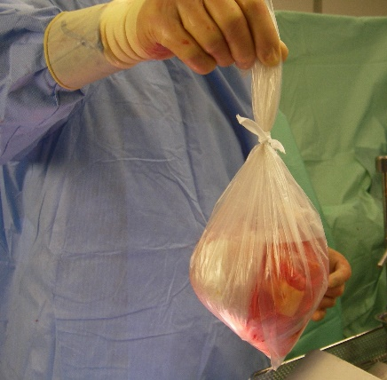
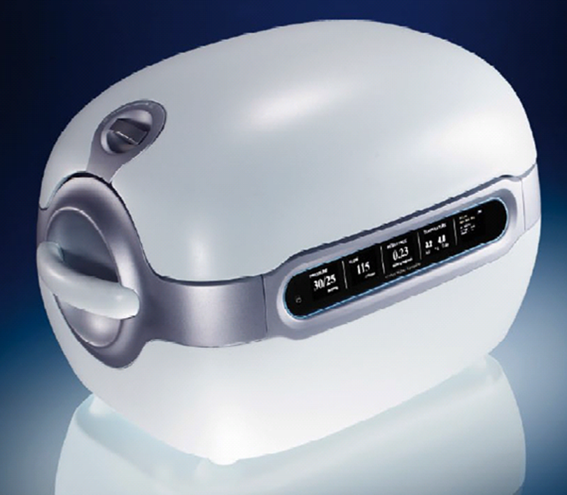

Procedure
Process of organ donation
  11. Procurement
      Organs procured by surgeons from donor hospital
      Correct conditioning of organs
      Accompanied or unaccompanied transport of organs to recipient hospital

Slide 42

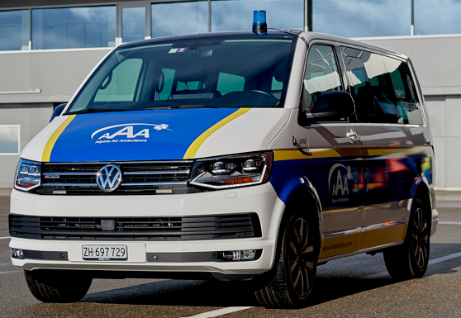

Procedure
Process of organ donation
  12. Transport
  Taxi, ambulance, helicopter, jet
  Ischemia time: the time interval between the interruption of the organ’s blood supply in the donor’s body and the resumption of the organ’s blood flow in the recipient’s body
Heart
Lungs/liver/pancreas
Kidneys
3−4 h
6−8 h
12−24 h

Slide 43
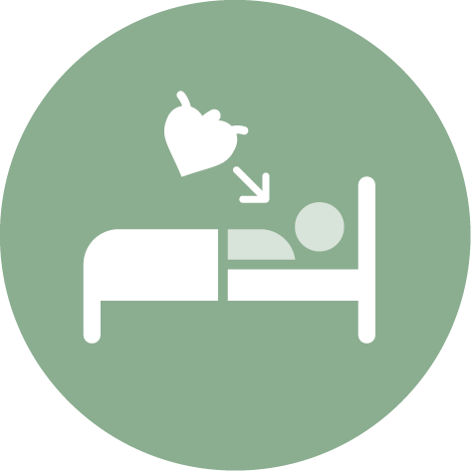
Procedure
Process of organ donation
  13. Transplantation
      Preliminary examinations carried out on the recipient
      Transplantation carried out in transplant centre
After a successful operation, the transplanted organ regains its function.

Slide 44
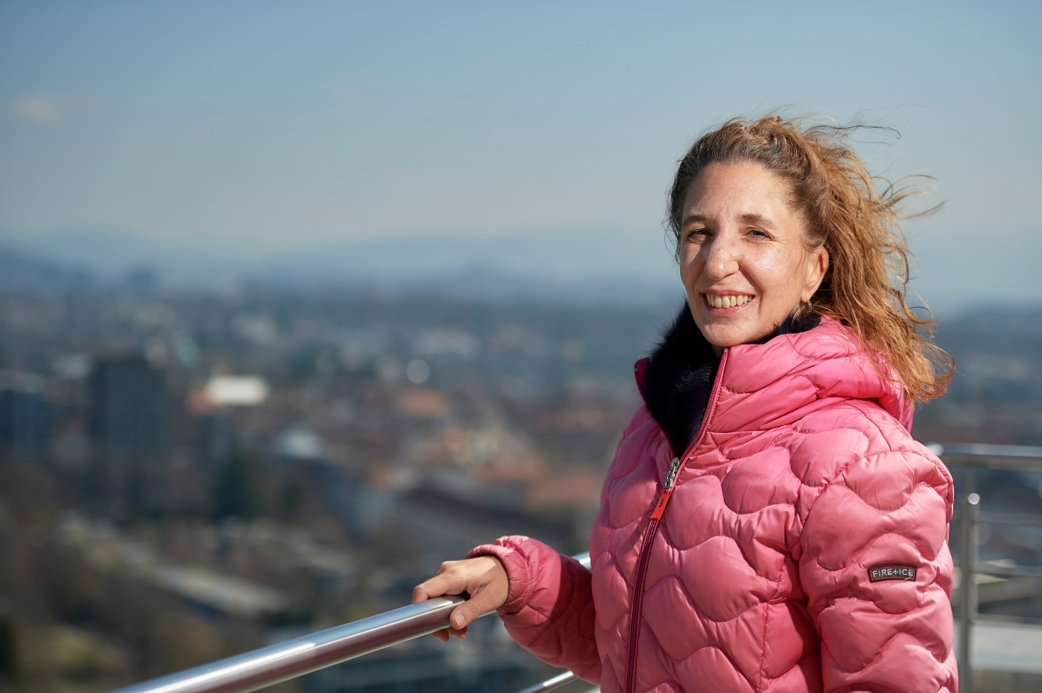
Organ recipients
After organ donation
  Improved quality of life
  Lifetime medication (immunosuppression)
  Prolongation of life
  Possibility to write an anonymous thank you letter to the donor family
Lara, liver transplant recipient

Slide 45
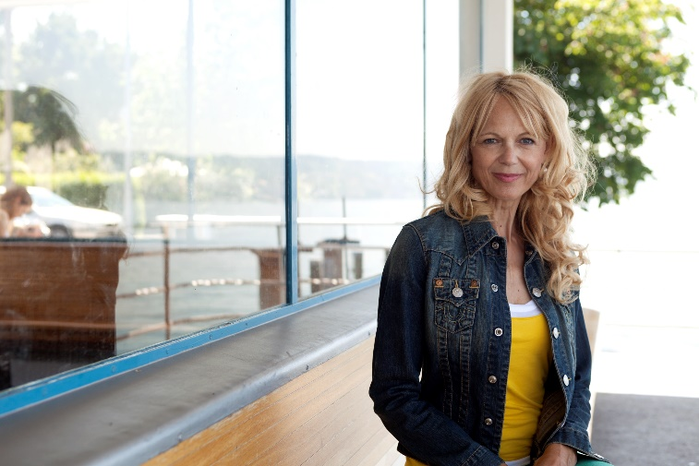
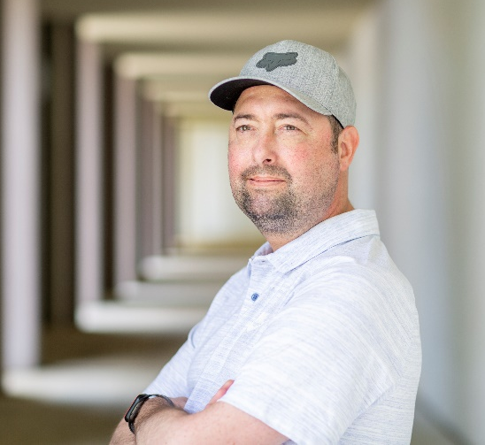
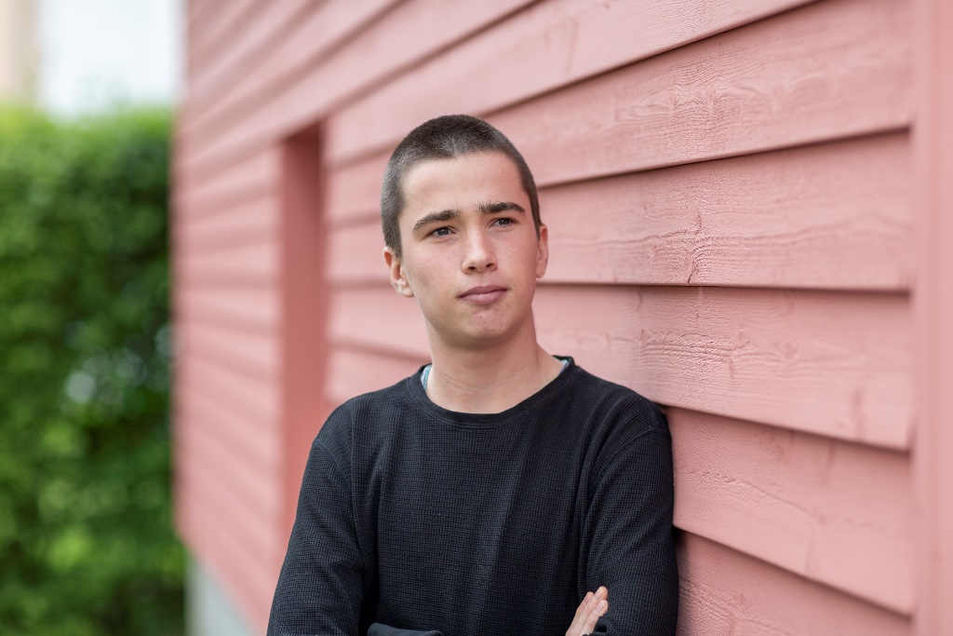
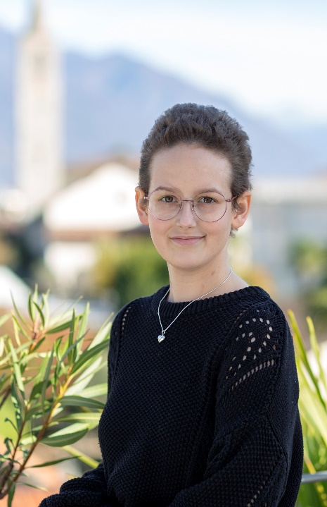

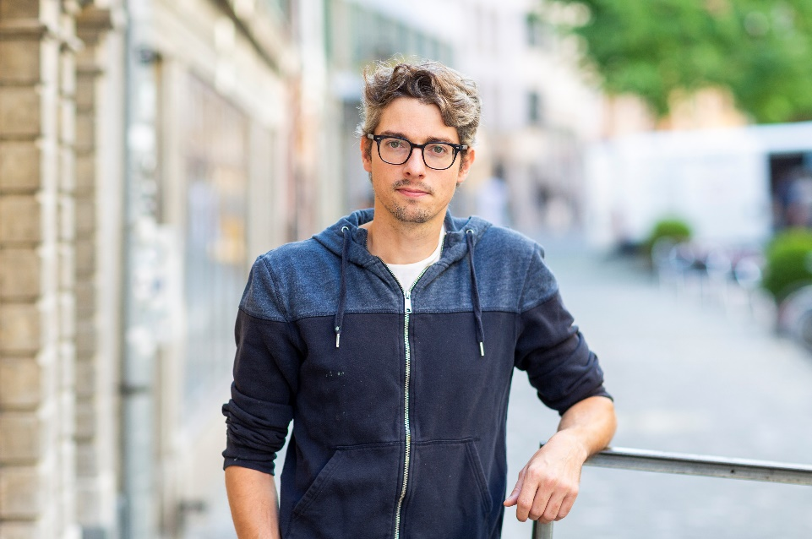
Organ recipients
Ambassadors
Renata, heart recipient
Sébastien, heart recipient
Maurice, kidney recipient
Lorena, heart recipient
Aline, heart recipient
Samuel, liver recipient

Slide 46
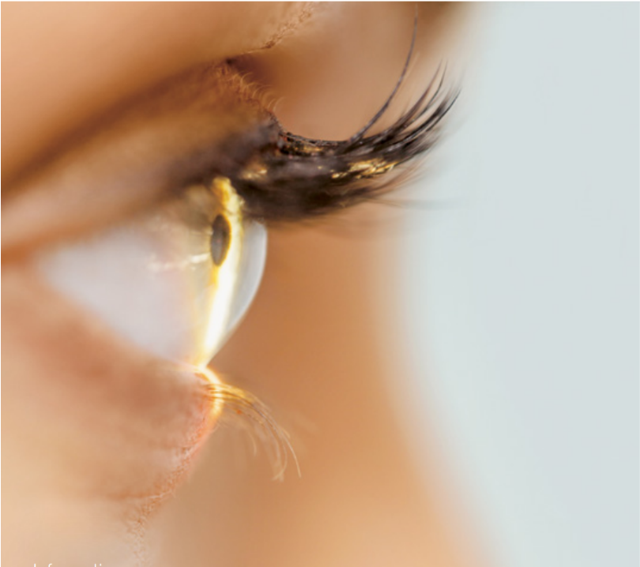

Tissue donation
After organ donation
      In case of death in hospital
      24−48 hours after death
      Consent
      Categories on donor card
        Cornea
        Cardiac valves, large blood vessels
        Vessels
      Corneal transplantation after eye injury, corneal infections (keratitis)

Slide 47


Saying goodbye
Process of organ donation
      Possibility for relatives to say goodbye to the deceased
      Funeral organized according to the wishes of the deceased and his or her relatives
      Last respects, cremation or burial possible
      Most important principle: dignified treatment both before and after the organ removal.

Slide 48
Questions
05
Swisstransplant
Thanks and conclusion

Slide 49
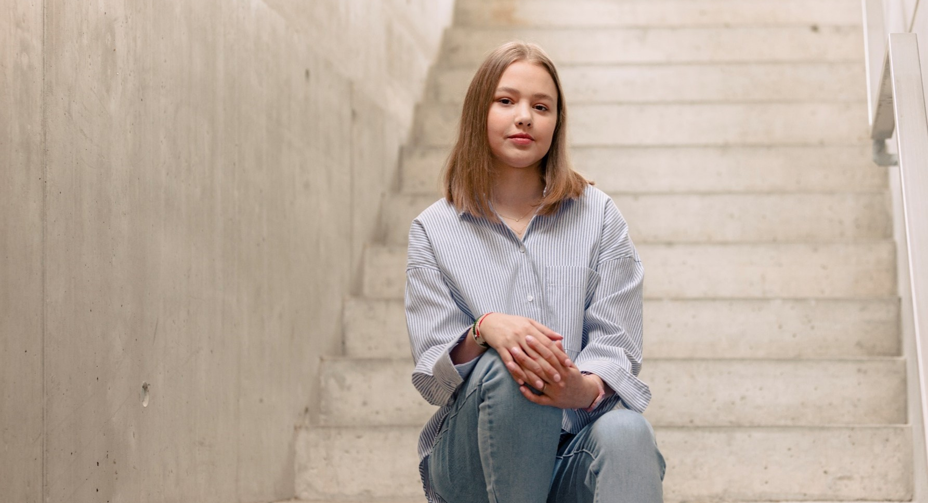
Thank you!
Swisstransplant
Effingerstrasse 1
Postfach
CH-3011 Bern
Telefon +41 58 123 80 00
www.swisstransplant.org
info@swisstransplant.org
© Swisstransplant
Ana, lung recipient

Slide 50
Videovorschläge für Ihre Präsentation:
Erweiterung Powerpoint
      Swisstransplant Vision und Mission: Swisstransplant Vision und Mission (untertitelt) (youtube.com)
      Erklärvideo: Wie funktioniert die Organspende in der Schweiz?: Erklärvideo: Wie funktioniert die Organspende in der Schweiz? (youtube.com)
      Wann ist ein Mensch tot?: Wann ist ein Mensch tot? (youtube.com)
      Digitalisierungsprozess Organspende und -Transplantation: Digitization process organ donation and transplantation (youtube.com)
      Noahs Organspende – Trauer und Hoffnung: Noahs Organspende – Trauer und Hoffnung (youtube.com)
      Ein ganz normales Leben: Ein ganz normales Leben / Une vie absolument normale / Una vita assolutamente normale (youtube.com)

